Slide 1
We are learning about atomic structure
TRACK WITH ME
READ WITH ME
Students will be able to:
Draw and label the structure of an atom
Determine the number of protons, neutrons and electrons in an element

Slide 2
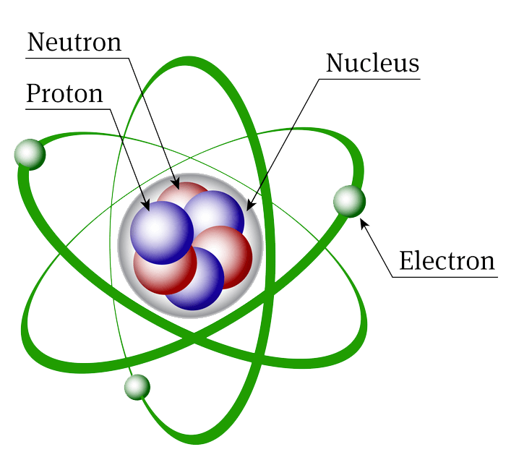
I will be able to use the periodic table to describe the structure of the atom
An atom is made up of protons, neutrons and electrons.
Protons and neutrons are found in the nucleus which is the centre of the atom.
Electrons are found in the electron cloud around the outside of the nucleus.

Slide 3
I will be able to use the periodic table to describe the structure of the atom
The atomic number at the top of the periodic table tells you the number of protons in an atom. This also tells you the number of electrons in an element.
The Mass number at the bottom of the element tells you the number of protons + neutrons.
To work out neutrons you need to subtract the atomic number from the mass number

Slide 4
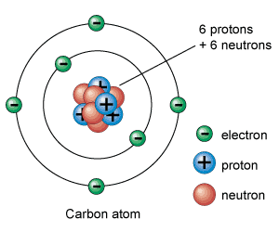
I will be able to use the periodic table to describe the structure of the atom
A proton has a positive charge and is found in the nucleus of an atom.
A neutron has no charge and is found in the nucleus of an atom
A electron has a negative charge and is found in rings (called shells) around the nucleus.

Slide 5
I will be able to use the periodic table to describe the structure of the atom
Can you see a pattern?
The number of protons increases as you move across the periodic table
That is how elements are defined between one another.

Slide 6
I will be able to use the periodic table to describe the structure of the atom
Can you fill in this table?
Upload a photo of this in your book to the submission link on connect

Slide 7
I will be able to use the periodic table to describe the structure of the atom
TRACK WITH ME
READ WITH ME
I can determine the number of protons, neutrons and electrons in an element
I can draw the structure of an atom (including number of electrons)

Slide 8
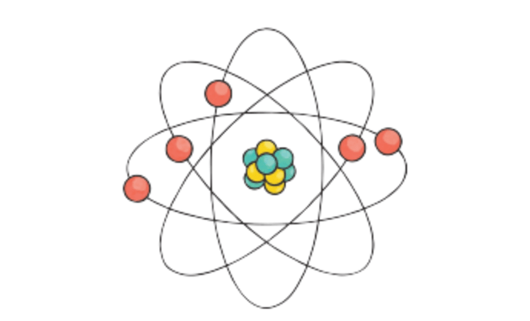
Repeat the opposite word/phrase.
ATOM
THE SMALLEST PARTICLE OF A CHEMICAL ELEMENT THAT CAN EXIST.

Slide 9
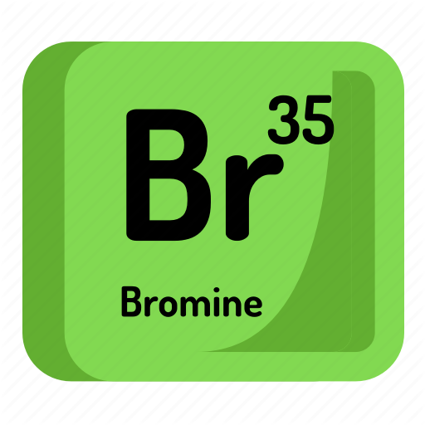
Repeat the opposite word/phrase.
ELEMENT
A SUBSTANCE THAT CONTAINS ONLY ONE TYPE OF ATOM

Slide 10
Repeat the opposite word/phrase.
ELEMENT
A SUBSTANCE THAT CONTAINS ONLY ONE TYPE OF ATOM

Slide 11
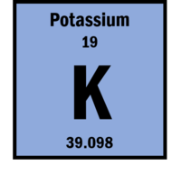
Repeat the opposite word/phrase.
Repeat the opposite word/phrase.
ATOMIC NUMBER
THE NUMBER OF PROTONS IN AN ATOM

Slide 13
Repeat the opposite word/phrase.
MASS NUMBER
THE NUMBER OF PROTONS AND NEUTRONS IN AN ATOM

Slide 14
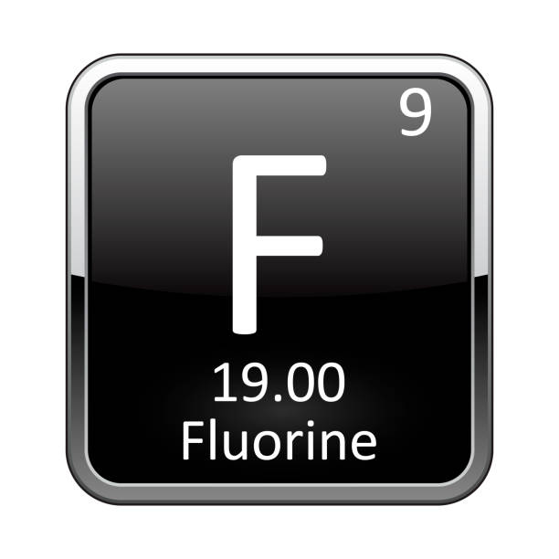
CALCULATING NEUTRONS

Slide 15
I will be able to use the periodic table to describe the structure of the atom
A proton has a positive charge and is found in the nucleus of an atom.
A neutron has no charge and is found in the nucleus of an atom
A electron has a negative charge and is found in rings (called shells) around the nucleus.

Slide 16
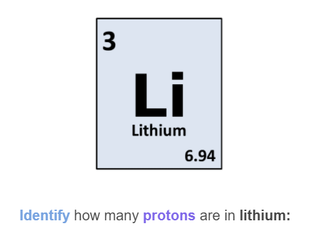

Slide 17
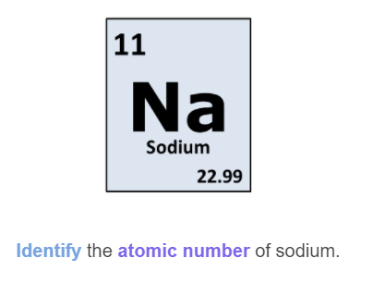

Slide 18
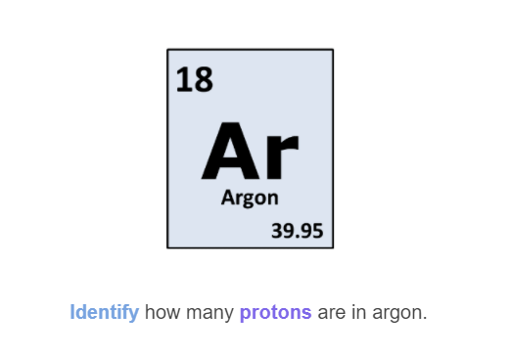

Slide 19
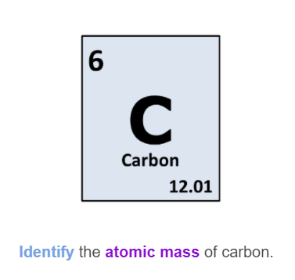

Slide 20
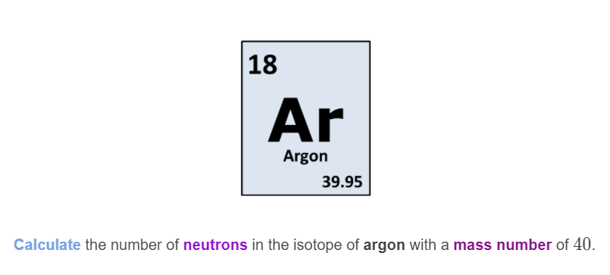

Slide 21
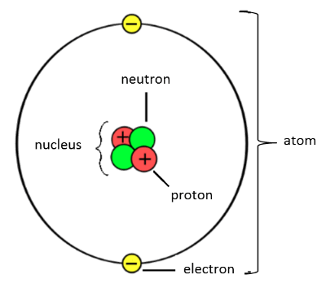
Protons and Neutrons make up the nucleus, which is at the centre of the atom.
Electrons are found in orbitals (or shells) around the outside of the nucleus

Slide 22
Protons are positively charged (+1)
Electrons are negatively charged (-1)
Neutrons have no charge (0)

Slide 23
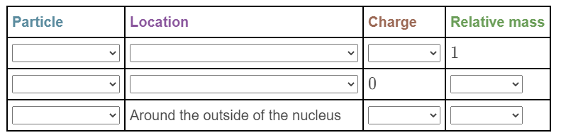

Slide 24
TEACHER CUE
CFU
HINT
Scaffolding for students
MAKE THE CONNECTION
Allow students to make the connection

Slide 26
Bloom’s Taxonomy Verbs for Learning Intentions: Create (design, construct, develop, investigate) Evaluate (argue, judge, support, critique) Analyse (organise, relate, compare, contrast, question, test) Apply (use, demonstrate, interpret, schedule, sketch) Understand (classify, describe, discuss, explain, identify, locate, recognize, select, translate) Remember (define, duplicate, list, memorise, repeat, state)
TRACK WITH ME
READ WITH ME

Slide 27
MAKE THE CONNECTION

Slide 28
MAKE THE CONNECTION

Slide 29
TEACHER CUE
CFU

Slide 30
TEACHER CUE
CFU

Slide 31
TEACHER CUE
CFU
HINT
Scaffolding for students
Notes:
Please include tasks/questions here rather than just referring to a worksheet. This will save on photocopying and facilitate sharing with other schools.
Try and build tasks/questions which escalate through Bloom’s Taxonomy. This will help with differentiation.

Slide 32
TRACK WITH ME
READ WITH ME

